Slide 1
Potential change to browser UI for Subject DN of EV SSL Certificate
Chunghwa Telecom Co., Ltd.
Li-Chun CHEN,
Deputy Senior Engineer, CISSP, CISM, CISA, PMP
realsky@cht.com.tw
CA/Browser Forum Meeting 39
Redmond , Host: Microsoft
October, 20 , 2016

Slide 2
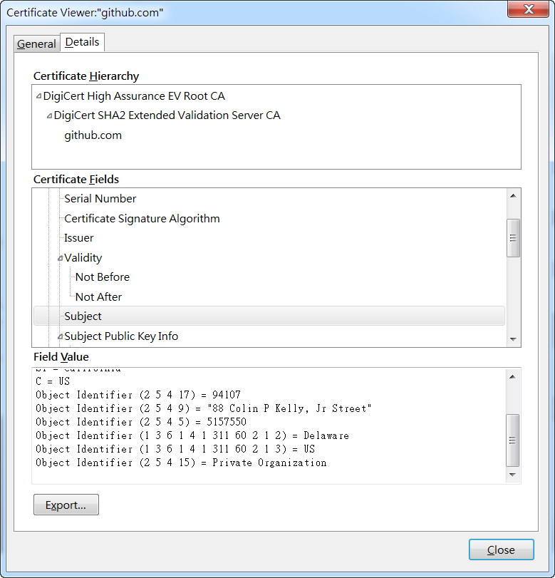
EV SSL Certificate Detailed Information of Subject DN view in Opera/Windows 7
Could the UI become :
CN = github.com
O = GitHub, Inc.
L = San Francisco
S = California
C = US
PostalCode = 94107
STREET = 88 Colin P Kelly, Jr Street
SERIALNUMBER = 5157550
Jurisdiction of Incorporation State or Province = Delaware
Jurisdiction of Incorporation Country = US
Business Category = Private

Slide 3
EV SSL Certificate Detailed Information of Subject DN view in Firefox/Windows 7
Could the UI become :
CN = github.com
O = GitHub, Inc.
L = San Francisco
S = California
C = US
PostalCode = 94107
STREET = 88 Colin P Kelly, Jr Street
SERIALNUMBER = 5157550
Jurisdiction of Incorporation State or Province = Delaware
Jurisdiction of Incorporation Country = US
Business Category = Private

Slide 4
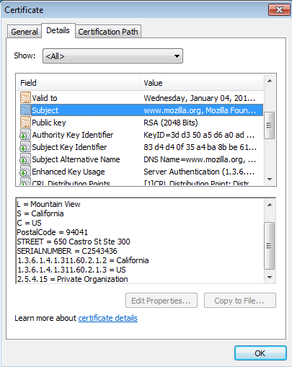
EV SSL Certificate Detailed Information of Subject DN view in IE /Windows 7
Could the UI become :
CN = www.mozilla.org
O = Mozilla Foundation
L = Mountain View
S = California
C = US
PostalCode = 94041
STREET = 650 Castro St Ste 300
SERIALNUMBER = C2543436
Jurisdiction of Incorporation State or Province = California
Jurisdiction of Incorporation Country = US
Business Category= Private Organization

Slide 5
Discussion 1
The UI for Details of Subject information of an EV SSL certificate by Safari, Chrome in windows is the same as view in IE/Windows
Could browser parse the OIDS like 1.3.6.1.4.1.311.60.2.1.2 as meaningful string?
It will greatly improve user experience to browser a important site installed by an EV SSL certificate.
Could the browser vendors' representatives help to ask the programming team if/when this request is met?

Slide 6
Mapping Table
OID | Proposed UI in details | Note
1.3.6.1.4.1.311.60.2.1.1 | Option 1: Jurisdiction State or Province Option 2: Jurisdiction of Incorporation State or Province | EVGL 9.2.5
1.3.6.1.4.1.311.60.2.1.2 | Option 1: Jurisdiction State or Province Option 2: Jurisdiction of Incorporation State or Province | EVGL 9.2.5
1.3.6.1.4.1.311.60.2.1.3 | Option 1: Jurisdiction of Country Option 2: Jurisdiction of Incorporation Country | EVGL 9.2.5
2.5.4.15 | Business Category | EVGL 9.2.4
2.5.4.17 | Postal Code | EVGL 9.2.7

Slide 7
Discussion 2
In EV GL, 9.2.5 Subject Jurisdiction of Incorporation or Registration Field
Certificate fields:
Locality (if required):
subject:jurisdictionLocalityName (OID: 1.3.6.1.4.1.311.60.2.1.1)
ASN.1 - X520LocalityName as specified in RFC 5280
State or province (if required):
subject:jurisdictionStateOrProvinceName (OID: 1.3.6.1.4.1.311.60.2.1.2)
ASN.1 - X520StateOrProvinceName as specified in RFC 5280
Country:
subject:jurisdictionCountryName (OID: 1.3.6.1.4.1.311.60.2.1.3)
ASN.1 – X520countryName as specified in RFC 5280

Slide 8
Discussion 2
For RFC 5280 PKIX Certificate and CRL Profile (https://www.ietf.org/rfc/rfc5280.txt)，page 112,
-- Naming attributes of type X520LocalityName
id-at-localityName AttributeType ::= { id-at 7 }
-- Naming attributes of type X520LocalityName:
-- X520LocalityName ::= DirectoryName (SIZE (1..ub-locality-name))
-- Expanded to avoid parameterized type:
X520LocalityName ::= CHOICE {
teletexString TeletexString (SIZE (1..ub-locality-name)),
printableString PrintableString (SIZE (1..ub-locality-name)),
universalString UniversalString (SIZE (1..ub-locality-name)),
utf8String UTF8String (SIZE (1..ub-locality-name)),
bmpString BMPString (SIZE (1..ub-locality-name)) }

Slide 9
Discussion 2
-- Naming attributes of type X520StateOrProvinceName
id-at-stateOrProvinceName AttributeType ::= { id-at 8 }
-- Naming attributes of type X520StateOrProvinceName:
-- X520StateOrProvinceName ::= DirectoryName (SIZE (1..ub-state-name))
--
-- Expanded to avoid parameterized type:
X520StateOrProvinceName ::= CHOICE {
teletexString TeletexString (SIZE (1..ub-state-name)),
printableString PrintableString (SIZE (1..ub-state-name)),
universalString UniversalString (SIZE (1..ub-state-name)),
utf8String UTF8String (SIZE (1..ub-state-name)),
bmpString BMPString (SIZE (1..ub-state-name)) }

Slide 10
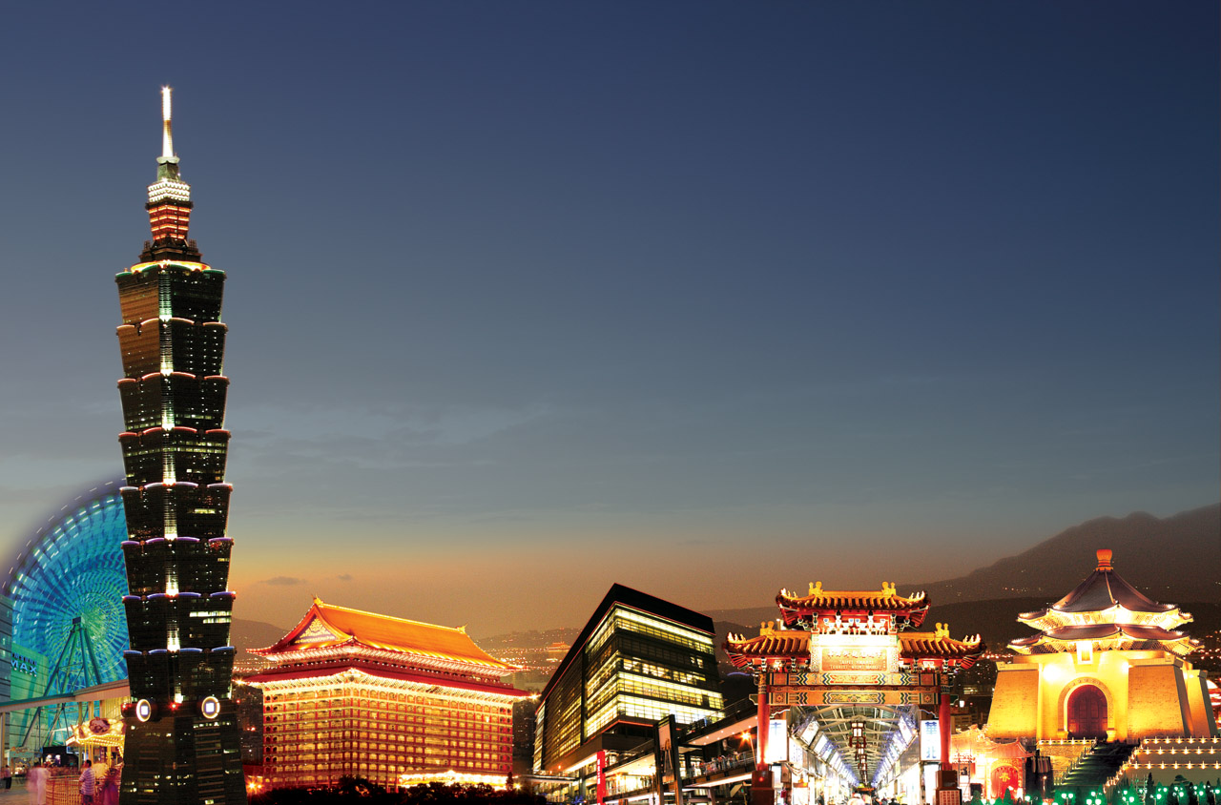
10
Value Creator for
Investors, Customers, Employees, and Society
Thank you!

