Slide 1
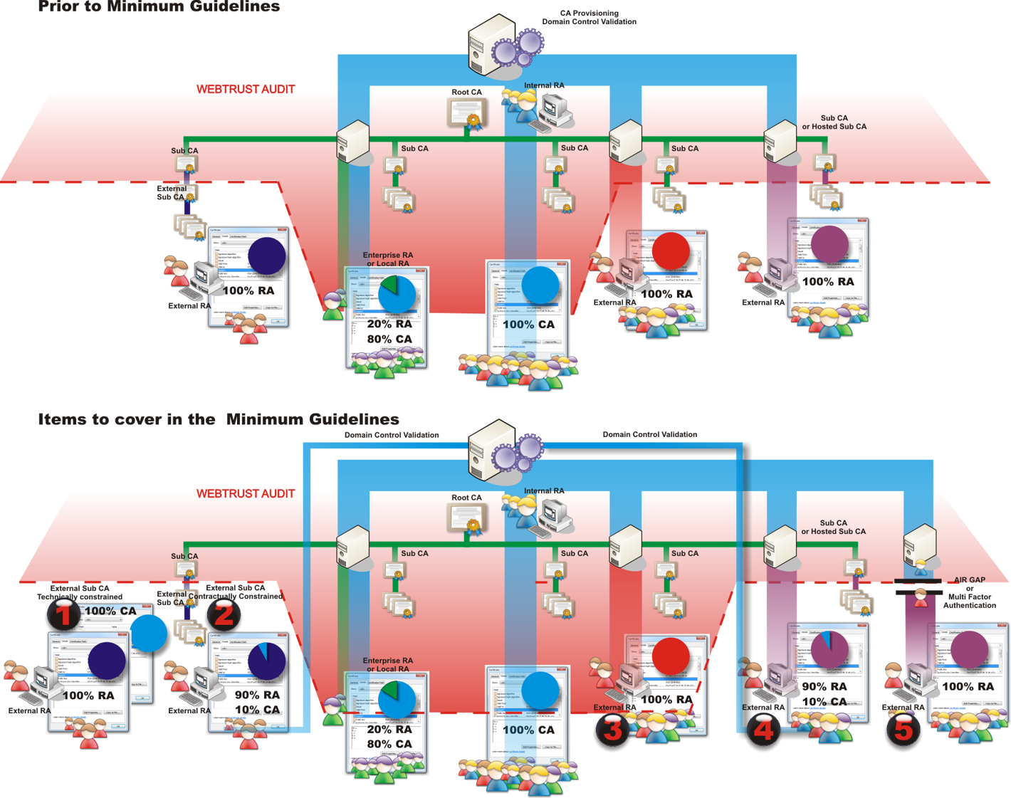
Potential
Weakness
(less due to H/W?)
Potential
Weakness!
Potential
Weakness!

